Slide 1
Docker
Unit V

Slide 2
Docker
Docker is an open source platform for building, deploying, and managing containerized applications.
It enables developers to package applications into containers—standardized executable components combining application source code with the operating system (OS) libraries and dependencies required to run that code in any environment.
Developers can create containers without Docker, but the platform makes it easier, simpler, and safer to build, deploy and manage containers. Docker is essentially a toolkit that enables developers to build, deploy, run, update, and stop containers using simple commands and work-saving automation through a single API.

Slide 3
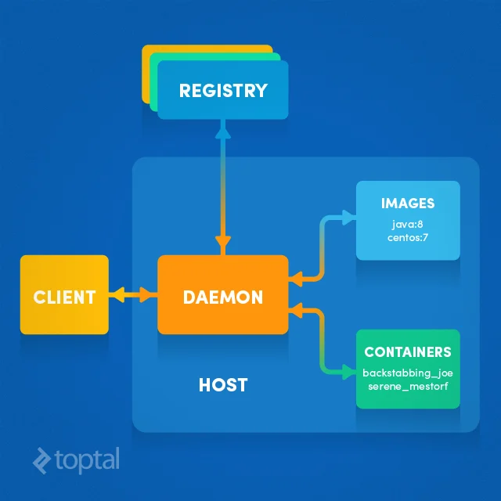
Docker Architecture

Slide 4
Docker Containers
Docker containers are the lightweight alternatives of the virtual machine. It allows developers to package up the application with all its libraries and dependencies, and ship it as a single package. The advantage of using a docker container is that you don't need to allocate any RAM and disk space for the applications. It automatically generates storage and space according to the application requirement.

Slide 5
Virtual Machine
A virtual machine is a software that allows us to install and use other operating systems (Windows, Linux) simultaneously on our machine. The operating system in which virtual machine runs are called virtualized operating systems. These virtualized operating systems can run programs and preforms tasks that we perform in a real operating system.

Slide 6
Containers Vs. Virtual Machine
Containers | Virtual Machine
Integration in a container is faster and cheap. | Integration in virtual is slow and costly.
No wastage of memory. | Wastage of memory.
It uses the same kernel, but different distribution. | It uses multiple independent operating systems.

Slide 7
Why Docker?
Docker is designed to benefit both the Developer and System Administrator. There are the following reasons to use Docker -
Docker allows us to easily install and run software without worrying about setup or dependencies.
Developers use Docker to eliminate machine problems
Operators use Docker to run and manage apps in isolated containers for better compute density.
Enterprises use Docker to securely built agile software delivery pipelines to ship new application features faster and more securely.
Since docker is not only used for the deployment, but it is also a great platform for development, that's why we can efficiently increase our customer's satisfaction.

Slide 8
Advantages of Docker
There are the following advantages of Docker -
It runs the container in seconds instead of minutes.
It uses less memory.
It provides lightweight virtualization.
It does not a require full operating system to run applications.
It uses application dependencies to reduce the risk.
Docker allows you to use a remote repository to share your container with others.
It provides continuous deployment and testing environment.

Slide 9
Disadvantages of Docker
There are the following disadvantages of Docker -
It increases complexity due to an additional layer.
In Docker, it is difficult to manage large amount of containers.
Some features such as container self -registration, containers self-inspects, copying files form host to the container, and more are missing in the Docker.
Docker is not a good solution for applications that require rich graphical interface.
Docker provides cross-platform compatibility means if an application is designed to run in a Docker container on Windows, then it can't run on Linux or vice versa.

Slide 10
Docker Image
A Docker image is made up of a collection of files that bundle together all the essentials – such as installations, application code, and dependencies – required to configure a fully operational container environment. You can create a Docker image by using one of two methods:
Interactive: By running a container from an existing Docker image, manually changing that container environment through a series of live steps, and saving the resulting state as a new image.
Dockerfile: By constructing a plain-text file, known as a Dockerfile, which provides the specifications for creating a Docker image.

Slide 11
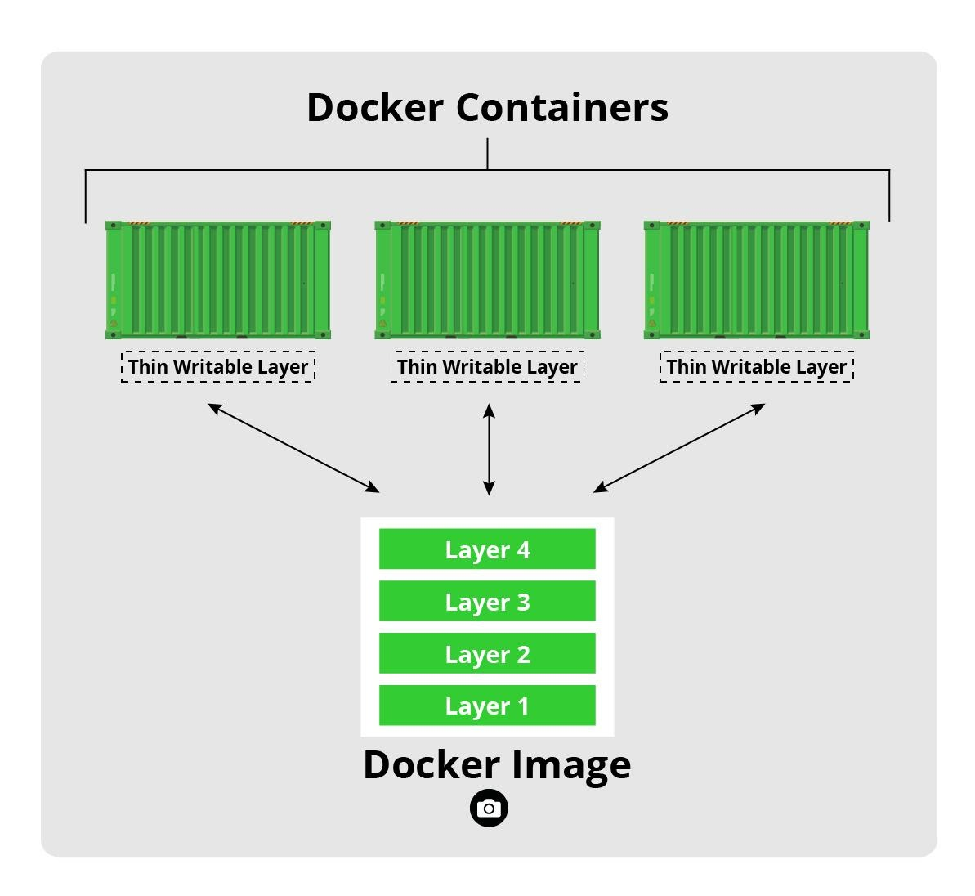
Image Layers
Each of the files that make up a Docker image is known as a layer. These layers form a series of intermediate images, built one on top of the other in stages, where each layer is dependent on the layer.
Container Layer
Each time Docker launches a container from an image, it adds a thin writable layer, known as the container layer, which stores all changes to the container throughout its runtime.

Slide 12
Container Registries
Container registries are catalogs of storage locations, known as repositories, where you can push and pull container images. The three main registry types are:
Docker Hub: Docker’s own, official image resource where you can access more than 100,000 container images shared by software vendors, open-source projects, and Docker’s community of users. You can also use the service to host and manage your own private images.
Third-party registry services: Fully managed offerings that serve as a central point of access to your own container images, providing a way to store, manage, and secure them without the operational headache of running your own on-premises registry.
Self-hosted registries: A registry model favored by organizations that prefer to host container images on their own on-premises infrastructure – typically due to security, compliance concerns or lower latency requirements. To run your own self-hosted registry, you’ll need to deploy a registry server. Alternatively, you can set up your own private, remote, and virtual Docker registry.

Slide 13
Container Repositories
Container repositories are the specific physical locations where your Docker images are actually stored, whereby each repository comprises a collection of related images with the same name. Each of the images within a repository is referenced individually by a different tag and represents a different version of fundamentally the same container deployment. For example, on Docker Hub, mysql is the name of the repository that contains different versions of the Docker image for the popular, open-source DBMS, MySQL.

Slide 14
How to Create a Docker Image
the two different methods of creating Docker images
Interactive Method
Dockerfile Method

Slide 15
Interactive Method
The following is a set of simplified steps to creating an image interactively:
Install Docker and launch the Docker engine
Open a terminal session
Use the following Docker run command to start an interactive shell session with a container launched from the image specified by image_name:tag_name:
$ docker run -it image_name:tag_name bash

Slide 16
Interactive Method
If you omit the tag name, then Docker automatically pulls the most recent image version, which is identified by the latest tag. If Docker cannot find the image locally then it will pull what it needs to build the container from the appropriate repository on Docker Hub.
example, we’ll launch a container environment based on the latest version of Ubuntu:
$ docker run -it ubuntu bash
Now configure your container environment by, for example, installing all the frameworks, dependencies, libraries, updates, and application code you need. The following simple example adds an NGINX server:

Slide 17
Interactive Method
Open another Bash shell and type the following docker ps command to list active container processes:
$ docker ps
The sample output below shows our running container with the ID e61e8081866d and the name keen_gauss:
CONTAINER ID IMAGE COMMAND CREATED STATUS PORTS NAMES
e61e8081866d ubuntu “bash” 2 minutes ago Up 2 minutes keen_gauss
This name is randomly generated by the Docker daemon. But you can also identify your container with something more meaningful by assigning your own name using the – name operator in the Docker run command.

Slide 18
Interactive Method
Save your image using the Docker commit command, specifying either the ID or name of the container from you which want to create it:
$ docker commit keen_gauss ubuntu_testbed
Now, use the Docker images command to see the image you’ve just created:
$ docker images
You should see your new image listed in the results.
REPOSITORY TAG IMAGE ID CREATED SIZE ubuntu latest 775349758637 5 minutes ago 64.2MB
Finally, return to your interactive container shell and type exit to shut it down.
# exit

Slide 19
Interactive Method
Advantages: Quickest and simplest way to create Docker images. Ideal for testing, troubleshooting, determining dependencies, and validating processes.
Disadvantages: Difficult lifecycle management, requiring error-prone manual reconfiguration of live interactive processes. Easier to create unoptimized images with unnecessary layers.

Slide 20
Dockerfile Method
The Dockerfile approach is the method of choice for real-world, enterprise-grade container deployments.
It’s a more systematic, flexible, and efficient way to build Docker images and the key to compact, reliable, and secure container environments.
The Dockerfile method is a three-step process whereby you create the Dockerfile and add the commands you need to assemble the image.

Slide 21
The following table shows you those Dockerfile statements you’re most likely to use:
Command | Purpose
FROM | To specify the parent image.
WORKDIR | To set the working directory for any commands that follow in the Dockerfile.
RUN | To install any applications and packages required for your container.
COPY | To copy over files or directories from a specific location.
ADD | As COPY, but also able to handle remote URLs and unpack compressed files.
ENTRYPOINT | Command that will always be executed when the container starts. If not specified, the default is /bin/sh -c
CMD | Arguments passed to the entrypoint. If ENTRYPOINT is not set (defaults to /bin/sh -c), the CMD will be the commands the container executes.
EXPOSE | To define which port through which to access your container application.
LABEL | To add metadata to the image.

Slide 22
The Docker Build Context
Now use the Docker build command to create your Docker image. Use the -t flag to set an image name and tag:
$ docker build -t my-nginx:0.1 .
you can use the Docker images command to see the image you’ve just created.
$ docker images
REPOSITORY TAG IMAGE ID CREATED SIZE
my-nginx 0.1 f95ae2e1344b 10 seconds ago 138MB
ubuntu 18.04 ccc6e87d482b 12 days ago 64.2MB

Slide 23
Dockerfile Method
Advantages: Clean, compact and repeatable recipe-based images. Easier lifecycle management and easier integration into continuous integration (CI) and continuous delivery (CD) processes. Clear self-documented record of steps taken to assemble the image.
Disadvantages: More difficult for beginners and more time consuming to create from scratch.

Slide 24
How to install docker on Windows
Install docker on any operating system like Windows, Linux, or Mac. Here, we are going to install docker-engine on Windows. The main advantage of using Docker on Windows is that it provides an ability to run natively on Windows without any kind of virtualization. To install docker on windows, we need to download and install the Docker Toolbox.

Slide 25
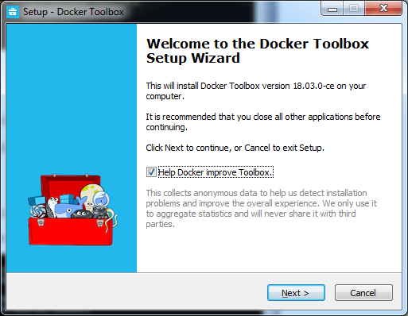
Follow the below steps to install docker on windows -
Step 1: Click on the below link to download DockerToolbox.exe. https://download.docker.com/win/stable/DockerToolbox.exe
Step 2: Once the DockerToolbox.exe file is downloaded, double click on that file. The following window appears on the screen, in which click on the Next.

Slide 26
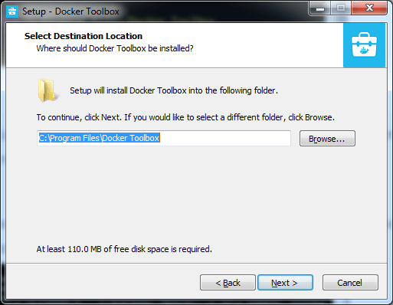
Follow the below steps to install docker on windows -
Step 3: Browse the location where you want to install the Docker Toolbox and click on the Next.

Slide 27
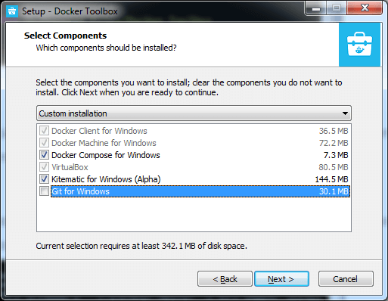
Follow the below steps to install docker on windows -
Step 4: Select the components according to your requirement and click on the Next.

Slide 28
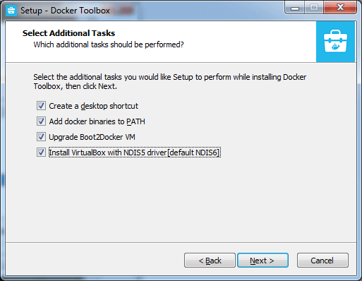
Follow the below steps to install docker on windows -
Step 5: Select Additional Tasks and click on the Next.

Slide 29
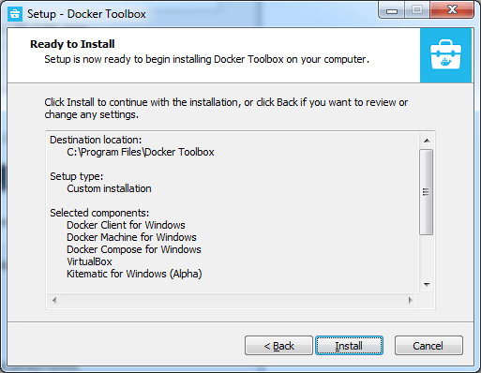
Follow the below steps to install docker on windows -
Step 6: The Docker Toolbox is ready to install. Click on Install.

Slide 30
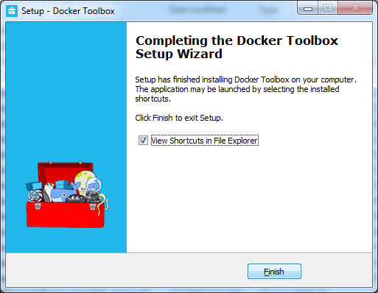
Follow the below steps to install docker on windows -
Step 7: Once the installation is completed, the following Wizard appears on the screen, in which click on the Finish.

Slide 31
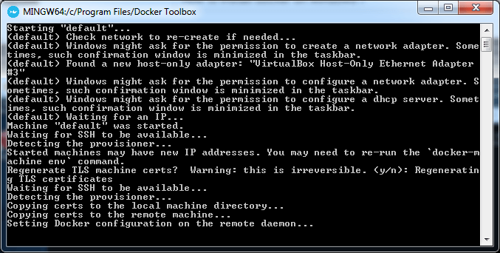
Follow the below steps to install docker on windows -
Step 8: After the successful installation, three icons will appear on the screen that are: Docker Quickstart Terminal, Kitematic (Alpha), and OracleVM VirtualBox. Double click on the Docker Quickstart Terminal.
Step 9: A Docker Quickstart Terminal window appears on the screen.

Slide 32
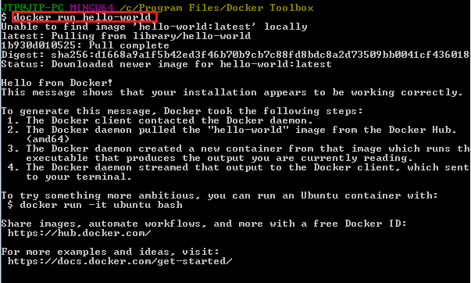
Follow the below steps to install docker on windows -
To verify that the docker is successfully installed, type the below command and press enter key. docker run hello-world
The following output will be visible on the screen, otherwise not.

Slide 33

Follow the below steps to install docker on windows -
You can check the Docker version using the following command.
docker -version

Slide 34
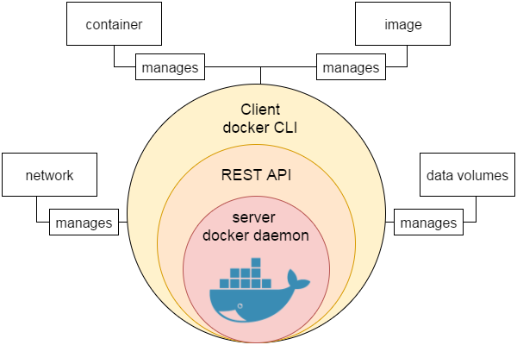
Docker Engine
It is a client server application that contains the following major components.
A server which is a type of long-running program called a daemon process.
The REST API is used to specify interfaces that programs can use to talk to the daemon and instruct it what to do.
A command line interface client.

Slide 35
How to Create a Docker Image From a Container
Step 1: Create a Base Container
Step 2: Inspect Images
Step 3: Inspect Containers
Step 4: Start the Container
Step 5: Modify the Running Container
Step 6: Create an Image From a Container
Step 7: Tag the Image
Step 8: Create Images With Tags
Step 9: Delete the Original Container
Step 10: Look at Running Containers
Step 11: Consider Your Options

Slide 36
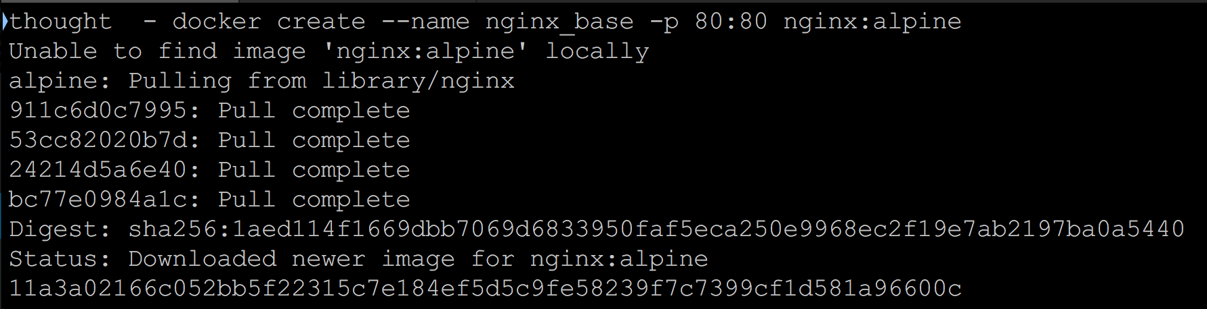
Step 1: Create a Base Container
The Docker create command will create a new container for us from the command line:
Here we have requested a new container named nginx_base with port 80 exposed to localhost. We are using nginx:alpine as a base image for the container.

Slide 37
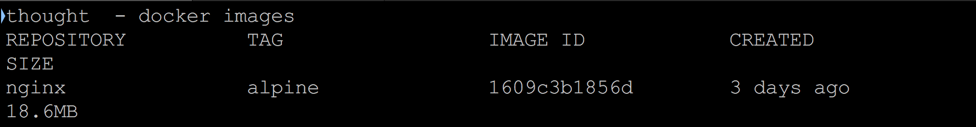
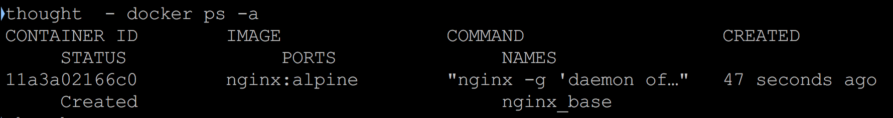
Step 2: Inspect Images
If you look at the list of images on your system, you will now see the nginx:alpine image:
Step 3: Inspect Containers

Slide 38
Step 4: Start the Container
start the container
Step 5: Modify the Running Container
create a new index.html file and copy it onto the running container. Using an editor on your machine, create an index.html file in the same directory that you have been running Docker commands from.
Then paste the following HTML into it:
<html>
<head>
<title>Hi Mom</title>
</head>
<body>
<h1>Hi Mom!</h1>
</body>
Then save the file and return to the command line. We will use the docker cp command to copy this file onto the running container.

Slide 39
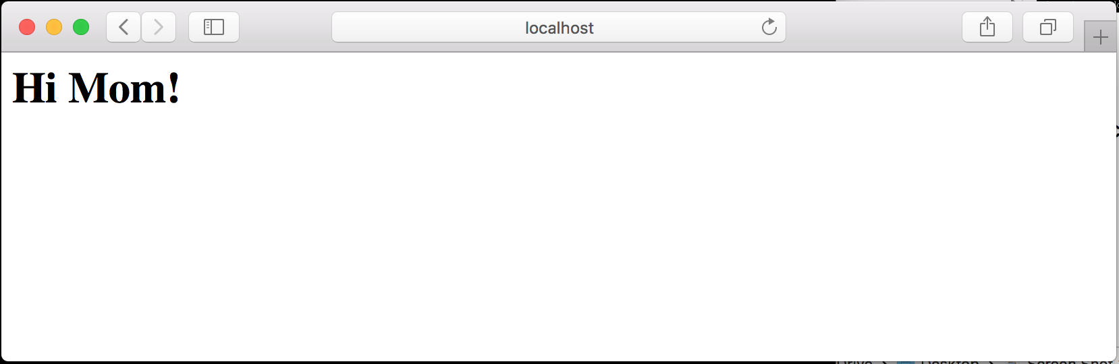
Modify the Running Container
Now reload your browser or revisit http://localhost. You will see the message “Hi Mom!” in place of the default nginx welcome page.

Slide 40
Step 6: Create an Image From a Container
Two way create the images
Interactive Method
Dockerfile Method
After crate the images updated the contents of a running container
To save a Docker container

Slide 41
Step 7: Tag the Image
Using docker tag, need the image ID for the command, our command will be:
Step 8: Create Images With Tags
Tag the image as it is created by adding another argument to the end of the command like this:

Slide 42
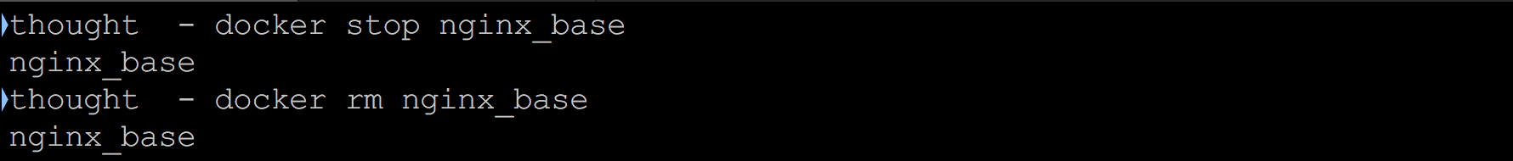
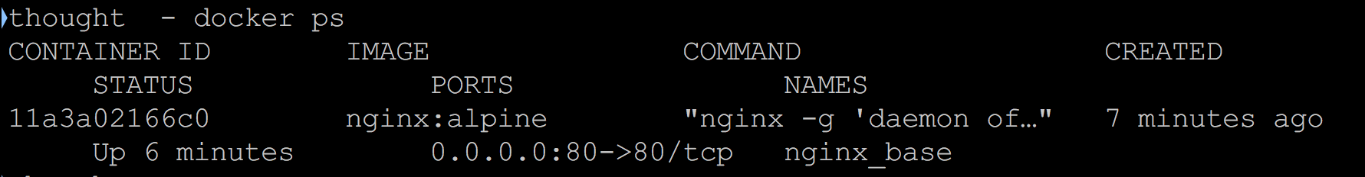
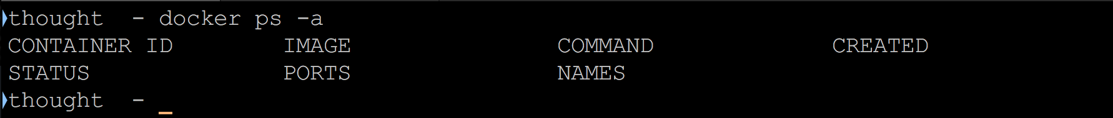
Step 9: Delete the Original Container
stop the Docker container that is currently running and delete
Using the docker ps command before
After

Slide 43
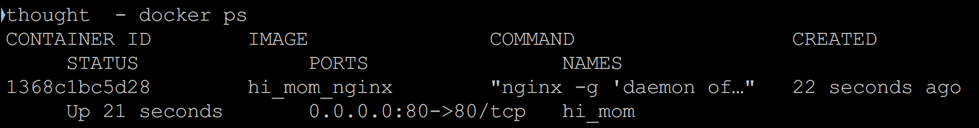
Step 10: Look at Running Containers
If you look at the running containers now, you will see we have one called hi_mom:
Stop the container hi_mom

Slide 44
Step 11: Consider Your Options
There are a few optional things we can do using the commit command that will change information about our images.
Option A: Set Authorship
Option B: Create Commit Messages
Option C: Commit Without Pause
Option D: Change Configuration

Slide 45
Command Line Interface
Available Commands
attach – Attach to a running container
build – Build a container from Dockerfile via stdin
commit – Create a new image from a container’s changes
diff – Inspect changes on a container’s filesystem
export – Stream the contents of a container as a tar archive
history – Show the history of an image
images – List images
import – Create a new filesystem image from the contents of a tarball
info – Display system-wide information
inspect – Return low-level information on a container
kill – Kill a running container
login – Register or Login to the docker registry server

Slide 46
Command Line Interface
logs – Fetch the logs of a container
port – Lookup the public-facing port which is NAT-ed to PRIVATE_PORT
ps – List containers
pull – Pull an image or a repository from the docker registry server
push – Push an image or a repository to the docker registry server
restart – Restart a running container
rm – Remove a container
rmi – Remove an image
run – Run a command in a new container
start – Start a stopped container
stop – Stop a running container
tag – Tag an image into a repository
version – Show the docker version information
wait – Block until a container stops, then print its exit code

Slide 47
Environment variables
The following list of environment variables are supported by the docker command line:
Variable | Description
DOCKER_API_VERSION | Override the negotiated API version to use for debugging (e.g. 1.19)
DOCKER_CERT_PATH | Location of your authentication keys. This variable is used both by the docker CLI and the dockerd daemon
DOCKER_CONFIG | The location of your client configuration files.
DOCKER_CONTENT_TRUST_SERVER | The URL of the Notary server to use. Defaults to the same URL as the registry.
DOCKER_CONTENT_TRUST | When set Docker uses notary to sign and verify images. Equates to --disable-content-trust=false for build, create, pull, push, run.
DOCKER_CONTEXT | Name of the docker context to use (overrides DOCKER_HOST env var and default context set with docker context use)
DOCKER_DEFAULT_PLATFORM | Default platform for commands that take the --platform flag.

Slide 48
Environment variables
DOCKER_HIDE_LEGACY_COMMANDS | When set, Docker hides “legacy” top-level commands (such as docker rm, and docker pull) in docker help output, and only Management commands per object-type (e.g., docker container) are printed. This may become the default in a future release, at which point this environment-variable is removed.
DOCKER_HOST | Daemon socket to connect to.
DOCKER_STACK_ORCHESTRATOR | Configure the default orchestrator to use when using docker stack management commands.
DOCKER_TLS_VERIFY | When set Docker uses TLS and verifies the remote. This variable is used both by the docker CLI and the dockerd daemon
BUILDKIT_PROGRESS | Set type of progress output (auto, plain, tty) when building with BuildKit backend. Use plain to show container output (default auto).

Slide 49
Overview of Docker Compose
Compose is a tool for defining and running multi-container Docker applications.
Compose works in all environments: production, staging, development, testing, as well as CI workflows.
Using Compose is basically a three-step process:
Define your app’s environment with a Dockerfile so it can be reproduced anywhere.
Define the services that make up your app in docker-compose.yml so they can be run together in an isolated environment.
Run docker compose up and the Docker compose command starts and runs your entire app. You can alternatively run docker-compose up using the docker-compose binary.

Slide 50
A docker-compose.yml looks like this
version: "3.9" # optional since v1.27.0
services:
web:
build: .
ports:
- "5000:5000"
volumes:
- .:/code
- logvolume01:/var/log
links:
- redis
redis:
image: redis
volumes:
logvolume01: {}

Slide 51
Compose has commands for managing the whole lifecycle of your application:
Start, stop, and rebuild services
View the status of running services
Stream the log output of running services
Run a one-off command on a service

Slide 52
Compose documentation
Installing Compose
Getting started with Compose
Get started with Django
Get started with Rails
Get started with WordPress
Frequently asked questions
Command line reference
Compose file reference

Slide 53
Features
The features of Compose that make it effective are:
Multiple isolated environments on a single host
Preserve volume data when containers are created
Only recreate containers that have changed
Variables and moving a composition between environments

Slide 54
Docker Compose ─ Installation
Step 1 − Download the necessary files from github using the following command
curl -L "https://github.com/docker/compose/releases/download/1.10.0-rc2/dockercompose
-$(uname -s) -$(uname -m)" -o /home/demo/docker-compose
The above command will download the latest version of Docker Compose which at the time of writing this article is 1.10.0-rc2. It will then store it in the directory /home/demo/.
Step 2 − Next, we need to provide execute privileges to the downloaded Docker Compose file, using the following command
chmod +x /home/demo/docker-compose

Slide 55
Docker Hub
Docker Hub is Docker’s official cloud-based registry for Docker images.
Docker Hub is Docker’s official registry, it is the default registry when you install Docker. It hosts over 100,000 images including official images for MongoDB, nginx, Apache, Ubuntu, and MySQL that have all been downloaded over a billion times each.
Docker Hub also offers features such as GitHub and Bitbucket integrations that help automate development build processes and support for webhooks which can act as triggers for everything from automated tests to notifications.

Slide 56
Why use Docker Hub?
A large library of trusted images- Docker Certified images, Verified Publisher images (which are Docker Certified and verified by the publisher), and Official Images published by Docker add a layer of trust for users.
Built-in security features- All accounts can benefit from local image vulnerability scans. “Team” accounts also gain access to audit-logs and multifactor authentication (MFA) to further secure repositories.
Integrations & features that enable CI/CD– Docker Hub also supports GitHub & Bitbucket integrations, automated tests, build triggers, and webhooks to help automate development pipelines and enable CI/CD (continuous integration/continuous delivery).

Slide 57
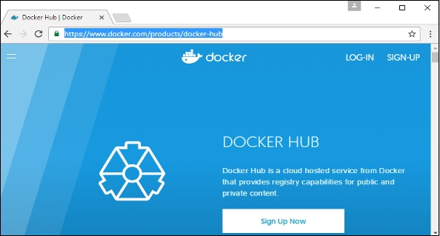
how to download and the use the Jenkins Docker image from Docker hub.
Step 1 − First you need to do a simple sign-up on Docker hub.

Slide 58
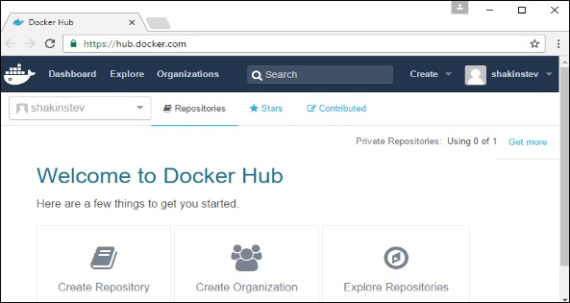
how to download and the use the Jenkins Docker image from Docker hub
Step 2 − Once you have signed up, you will be logged into Docker Hub.

Slide 59
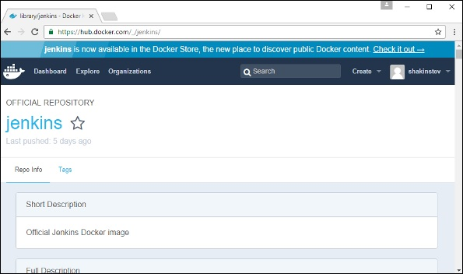
how to download and the use the Jenkins Docker image from Docker hub
Step 3 − Next, let’s browse and find the Jenkins image.

Slide 60
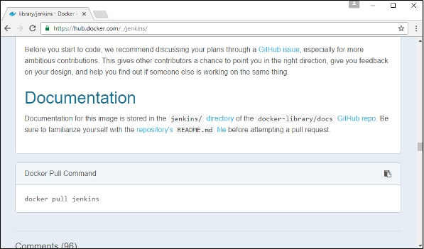
how to download and the use the Jenkins Docker image from Docker hub
Step 4 − If you scroll down on the same page, you can see the Docker pull command. This will be used to download the Jenkins image onto the local Ubuntu server.

Slide 61
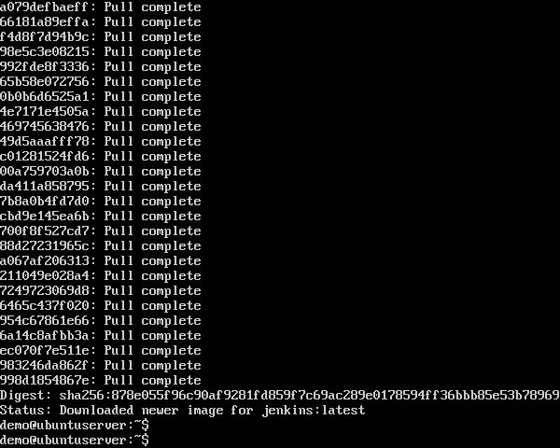
how to download and the use the Jenkins Docker image from Docker hub
Step 5 − Now, go to the Ubuntu server and run the following command
sudo docker pull jenkins

Slide 62
DTR (Docker Trusted Registry)
Docker Trusted Registry (DTR) is the enterprise-grade image storage solution from Docker. You install it behind your firewall so that you can securely store and manage the Docker images you use in your applications.
Docker trusted registry or simply Docker registry is an enterprise offering from Docker. the most common terminology that you will hear with Docker Enterprise Edition is DTR and UCP (universal control plane).
In order for DTR to work UCP has to be insallted and for UCP to be installed you owuld need Docker Enterprise Edition. Once you install Docker EE you can get a free liscense from DockerHub.

Slide 63
DTR Features
Image and job management - DTR has a user interface that allows authorized users in your organization to browse Docker images and review repository events.
Availability - DTR is highly available as it has multiple replicas of containers in case anything fails.
Efficiency - DTR has this ability to clean the unreferenced manifests and cache the images as well for faster pulling of images.
Built-in access control - STR has great authentication mechanisms like RBAC , LDAP sync. It uses the same authentication as of UCP.
Security scanning - Image Scanning is built in feature provided out of the box by DTR.

Slide 64
Docker Swarm
What is a Docker Swarm?
A Docker Swarm is a group of either physical or virtual machines that are running the Docker application and that have been configured to join together in a cluster. Once a group of machines have been clustered together, you can still run the Docker commands that you're used to, but they will now be carried out by the machines in your cluster. The activities of the cluster are controlled by a swarm manager, and machines that have joined the cluster are referred to as nodes.

Slide 65
What is Docker Swarm used for?
Docker swarm is a container orchestration tool, meaning that it allows the user to manage multiple containers deployed across multiple host machines.
One of the key benefits associated with the operation of a docker swarm is the high level of availability offered for applications. In a docker swarm, there are typically several worker nodes and at least one manager node that is responsible for handling the worker nodes' resources efficiently and ensuring that the cluster operates efficiently.

Slide 66
What are the two types of Docker Swarm mode services?
Docker Swarm has two types of services: replicated and global.
Replicated services: Swarm mode replicated services functions by you specifying a number of replica tasks for the swarm manager to assign to available nodes.
Global services: Global services function by using the swam manager to schedule one task to each available node that meets the services constraints and resource requirements.

Slide 67
What are Docker Swarm Nodes?
A docker swarm is comprised of a group of physical or virtual machines operating in a cluster. When a machine joins the cluster, it becomes a node in that swarm. The docker swarm function recognizes three different types of nodes, each with a different role within the docker swarm ecosystem
Docker Swarm Manager Node
Docker Swarm Leader Node
Docker Swarm Worker Node

Slide 68
Docker Swarm Manager Node
The primary function of manager nodes is to assign tasks to worker nodes in the swarm. Manager nodes also help to carry out some of the managerial tasks needed to operate the swarm. Docker recommends a maximum of seven manager nodes for a swarm.

Slide 69
Docker Swarm Leader Node
When a cluster is established, the Raft consensus algorithm is used to assign one of them as the "leader node". The leader node makes all of the swarm management and task orchestration decisions for the swarm. If the leader node becomes unavailable due to an outage or failure, a new leader node can be elected using the Raft consensus algorithm.

Slide 70
Docker Swarm Worker Node
In a docker swarm with numerous hosts, each worker node functions by receiving and executing the tasks that are allocated to it by manager nodes. By default, all manager modes are also worker nodes and are capable of executing tasks when they have the resources available to do so.

Slide 71
Docker Attach
Attach local standard input, output, and error streams to a running container
Use docker attach to attach your terminal’s standard input, output, and error (or any combination of the three) to a running container using the container’s ID or name. This allows you to view its ongoing output or to control it interactively, as though the commands were running directly in your terminal.
You can attach to the same contained process multiple times simultaneously, from different sessions on the Docker host.
To stop a container, use CTRL-c. This key sequence sends SIGKILL to the container. If --sig-proxy is true (the default),CTRL-c sends a SIGINT to the container. If the container was run with -i and -t, you can detach from a container and leave it running using the CTRL-p CTRL-q key sequence.

Slide 72
Override the detach sequence
If you want, you can configure an override the Docker key sequence for detach.
This is useful if the Docker default sequence conflicts with key sequence you use for other applications.
There are two ways to define your own detach key sequence,
as a per-container override or
as a configuration property on your entire configuration.

Slide 73
Override the detach sequence
To override the sequence for an individual container, use the --detach-keys="<sequence>" flag with the docker attach command. The format of the <sequence> is either a letter [a-Z], or the ctrl- combined with any of the following:
a-z (a single lowercase alpha character )
@ (at sign)
[ (left bracket)
\\ (two backward slashes)
_ (underscore)
^ (caret)

Slide 74
Options
Name, shorthand | Default | Description
--detach-keys |  | Override the key sequence for detaching a container
--no-stdin |  | Do not attach STDIN
--sig-proxy | true | Proxy all received signals to the process

Slide 75
What Is a Dockerfile?
When you run the Docker run command and specify WordPress, Docker uses this file to build the image itself. The Dockerfile is essentially the build instructions to build the image.
The advantage of a Dockerfile over just storing the binary image (or a snapshot/template in other virtualization systems) is that the automatic builds will ensure you have the latest version available.

Slide 76
Dockerfile Basics
The specific keywords you can use in a file are:
ADD copies the files from a source on the host into the container’s own filesystem at the set destination.
CMD can be used for executing a specific command within the container.
ENTRYPOINT sets a default application to be used every time a container is created with the image.
ENV sets environment variables.
EXPOSE associates a specific port to enable networking between the container and the outside world.
FROM defines the base image used to start the build process.
MAINTAINER defines a full name and email address of the image creator.
RUN is the central executing directive for Dockerfiles.
USER sets the UID (or username) which is to run the container.
VOLUME is used to enable access from the container to a directory on the host machine.
WORKDIR sets the path where the command, defined with CMD, is to be executed.
LABEL allows you to add a label to your docker image.

Slide 77
Docker Commands
The Top 15 Docker Commands that you will be using frequently while you are working with Docker.
docker –version
docker pull
docker run
docker ps
docker ps -a
docker exec
docker stop
docker kill
docker commit
docker login
docker push
docker images
docker rm
docker rmi
docker build

Slide 78
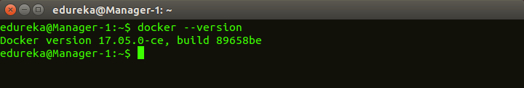
Docker Commands
1. docker –version
This command is used to get the currently installed version of docker

Slide 79
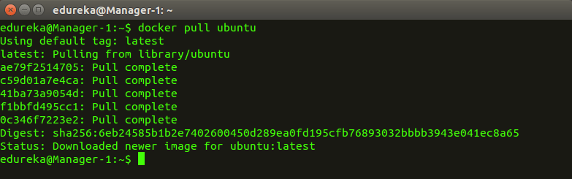
Docker Commands
2. docker pull
Usage: docker pull <image name>
This command is used to pull images from the docker repository(hub.docker.com)

Slide 80
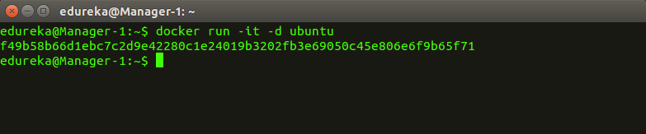
Docker Commands
3. docker run
Usage: docker run -it -d <image name>
This command is used to create a container from an image

Slide 81
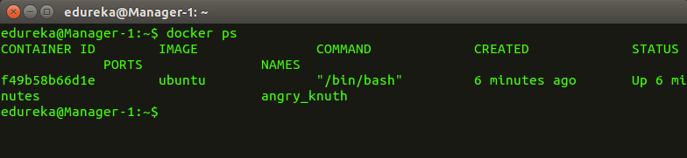
Docker Commands
4. docker ps
This command is used to list the running containers

Slide 82
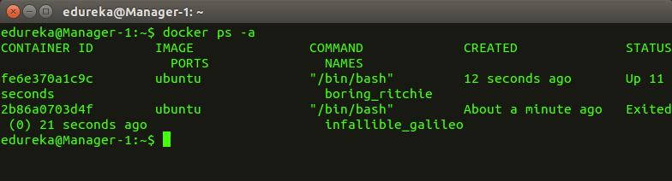
Docker Commands
5. docker ps –a
This command is used to show all the running and exited containers

Slide 83
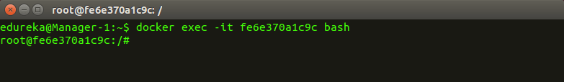
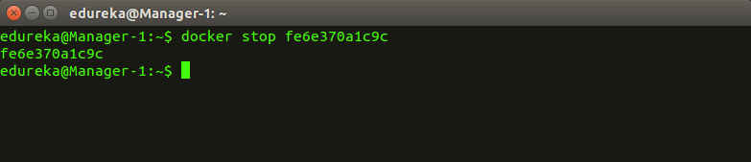
Docker Commands
6. docker exec
Usage: docker exec -it <container id> bash
This command is used to access the running container
7. docker stop
Usage: docker stop <container id>
This command stops a running container

Slide 84
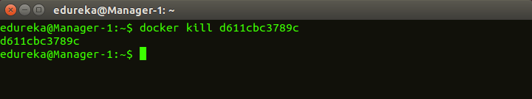
Docker Commands
8. docker kill
Usage: docker kill <container id>
This command kills the container by stopping its execution immediately. The difference between ‘docker kill’ and ‘docker stop’ is that ‘docker stop’ gives the container time to shutdown gracefully, in situations when it is taking too much time for getting the container to stop, one can opt to kill it

Slide 85
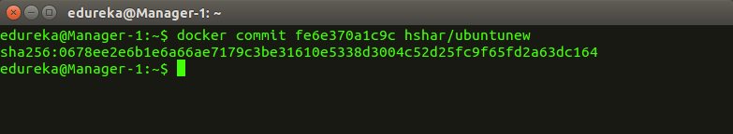
Docker Commands
9. docker commit
Usage: docker commit <conatainer id> <username/imagename>
This command creates a new image of an edited container on the local system

Slide 86
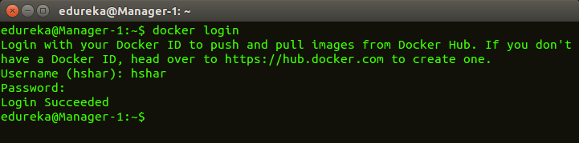
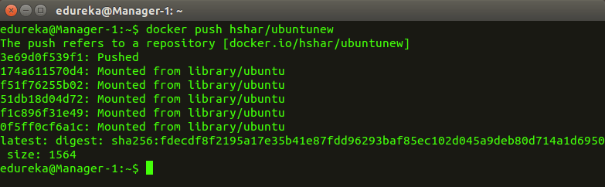
Docker Commands
10. docker login
This command is used to login to the docker hub repository
11. docker push
Usage: docker push <username/image name>
This command is used to push an image to the docker hub repository

Slide 87
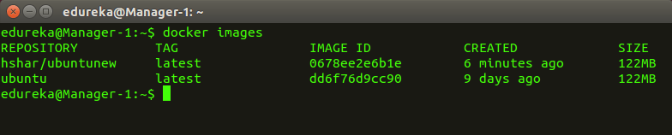
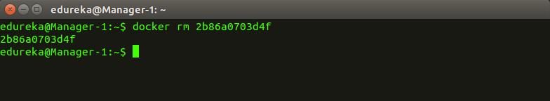
Docker Commands
12. docker images
This command lists all the locally stored docker images
13. docker rm
Usage: docker rm <container id>
This command is used to delete a stopped container

Slide 88
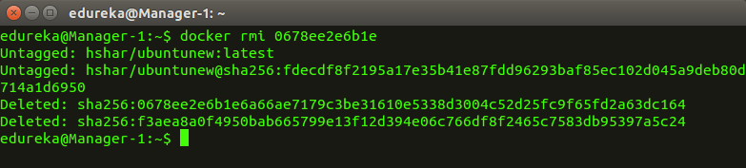
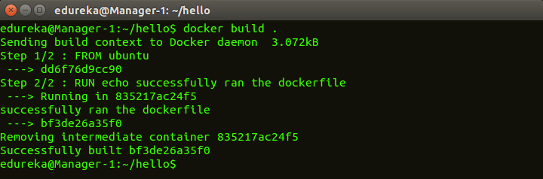
Docker Commands
14. docker rmi
Usage: docker rmi <image-id>
This command is used to delete an image from local storage
15. docker build
Usage: docker build <path to docker file>
This command is used to build an image from a specified docker file

